Slide 1


DOM
Dissolved Organic Matter (2022FA)
Investigating the optimal conditions to remove humic acid in water
More at https://github.com/AguaClara/Dissolved-Organic-Matter
Rachel Lai | rml267@cornell.edu Nhi Nguyen | npn25@cornell.edu
Zachary Kwon | zk49@cornell.edu Brooke Paykin | bsp67@cornell.edu
Dissolved Organic Matter | Research | Symposium Presentation Fall 2022 | Page 1
Notes:
Brooke
Hi we are DOM (dissolved organic matter). We were previously the subteams Humic Acid Removal and Activated Carbon. We are investigating the optimal conditions to remove dissolved organic matter in water. In the lab, we model dissolved organic matter with humic acid which we pump into our water. You can find more about our work on this github link. My name is Brooke … [Let everyone quickly introduce themselves]

Slide 2
Table of Contents
Background/Introduction
Schematic Drawing
Experimental Setup
Current Work
Results and Analysis
Conclusions and Future Directions
Dissolved Organic Matter | Research | Symposium Presentation Fall 2022 | Page 2
Notes:
Brooke
Read off the different components of this presentation

Slide 3
Goal
To determine the effectiveness of implementing coagulant with powdered activated carbon and/or clay to remove humic acid from drinking water to improve the capability of AguaClara water treatment plants.
Dissolved Organic Matter | Research | Symposium Presentation Fall 2022 | Page 3
Notes:
Brooke
This year we will focus on determining the effectiveness of implementing coagulant with powdered activated carbon and/or clay to remove humic acid from drinking water to improve the capability of AguaClara water treatment plants. The reason for studying this is because of problems with existing aguaclara plants.
Based on feedbacks from the plant operators from Gracias Honduras water treatment plant, there is a problem with flocs formed not being dense enough to be filtered out. That is why we are looking into whether or not clay and activated carbon can help form heavier, denser floccs that will settle better.

Slide 4
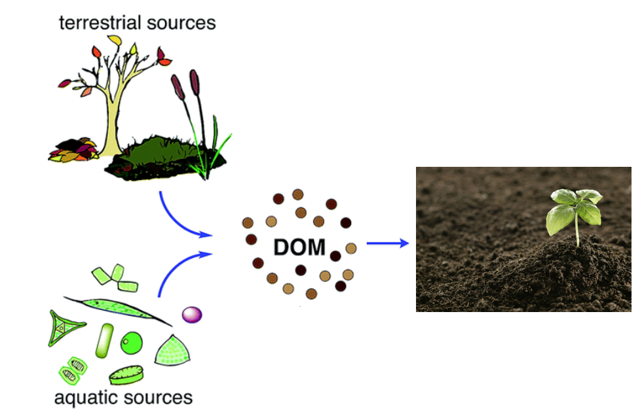
Background
What is humic acid (HA)?
Color, taste and odor problems
Increased heavy metals and organic pollutants
Reacts with chlorine to make chloroform
How can we deal with humic acid?
Flocculation
Coagulant
w/ Clay
w/ Powdered Activated Carbon (PAC)
Figure 1: Formation of dissolved organic material from terrestrial and aquatic sources
Dissolved Organic Matter | Research | Symposium Presentation Fall 2022 | Page 4
Notes:
Zach
What is humic acid?
Humic acid is a type of Dissolved Organic Matter (DOM), which consists of particles present in surface and groundwater and mainly results from plant and animal decay. Although humic acid is beneficial to plants because of their stimulation for plant growth and increase of plant disease resistance, it is a problem for the drinking water treatment process.
Humic acid has a negative effect on water quality because it causes problems with the color, taste, and odor of drinking water and is associated with increased levels of complex heavy metals and adsorbed organic pollutants. In addition, humic acid has the ability to react with chlorine, which creates a harmful byproduct known as chloroform.
How can we deal with humic acid in drinking water?
Our subteam’s method for removing humic acid from drinking water is through a process known as flocculation. Flocculation is driven by coagulant, which is a substance that clumps the impurities in water together in bunches -called flocs- that can be easily removed in the sedimentation tank. Thus, we need to determine a dosage of coagulant that is high enough to remove humic acid, but not enough to prevent flocculation.
After finding this optimal coagulant dosage, we will use coagulant with clay and/or activated carbon and optimize the resulting system to remove the most humic acid with the least amount of our solutions.
Information Citation:
Radian, A., &amp; Mishael, Y. (2012). Effect of humic acid on pyrene removal from water by polycation-clay mineral composites and activated carbon. Environmental Science &amp; Technology, 46(11), 6228–6235. https://doi.org/10.1021/es300964d
Image citation:
Lin, V. S. (2015). Research highlights: Challenges in the characterization, storage, and isolation of natural organic matter. Environmental Science: Processes & Impacts, 17(12), 2002–2005. https://doi.org/10.1039/c5em90046h

Slide 5
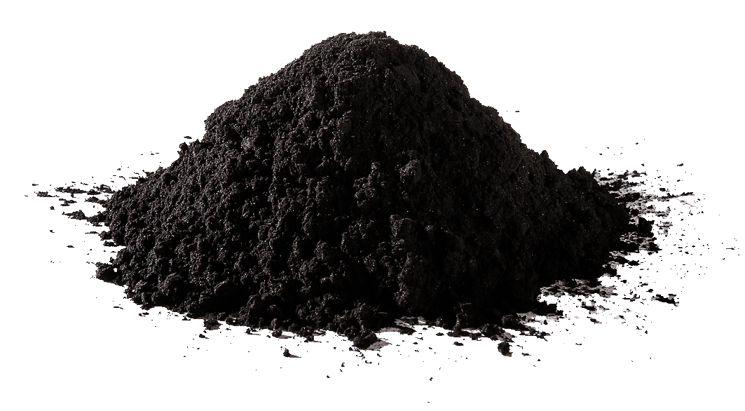
Background
How can clay and powdered activated carbon improve flocculation?
Create denser flocs
Porous and hydrophobic particles
Higher molar masses
Clay vs. Powdered Activated Carbon
Clay is less expensive
PAC is better at absorbing DOM
Figure 2: Powdered Activated Carbon (PAC) from Eleven Carbon Company
Dissolved Organic Matter | Research | Symposium Presentation Fall 2022 | Page 5
Notes:
Zach
How can clay and activated carbon improve flocculation?
Normally, according to Dr. Monroe Weber-Shirk, the flocs of humic acid and coagulant are not denser than water, which prevents the removal of such flocs in the sedimentation tank. Through the addition of clay and/or powdered activated carbon, denser flocs are able to be formed since these materials are porous, hydrophobic, and have higher molar masses.
Clay vs. Powdered Activated Carbon
In a meeting with Dr. Weber-Shirk, we spoke about the difference between clay and powdered activated carbon. According to Dr. Weber-Shirk, clay is less expensive than PAC, but PAC is better at adsorbing DOM. This statement was corroborated by a paper from Biswas et al. We plan to retrieve data justifying these statements and find optimal coagulant, clay, and PAC dosages to remove humic acid from drinking water.
Information Citation:
Biswas, S., Fatema, J., Debnath, T., &amp; Rashid, T. U. (2021). Chitosan–Clay Composites for wastewater treatment: A state-of-the-art review. ACS ES&amp;T Water, 1(5), 1055–1085. https://doi.org/10.1021/acsestwater.0c00207
Image Citation:
Powdered activated carbon. Eleven Carbon™. (2022, April 3). Retrieved October 17, 2022, from https://elevencarbon.com/powdered-activated-carbon/

Slide 6
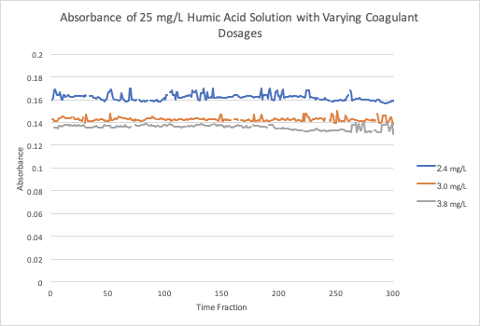
Work from Prior Semesters
Concentration of Humic Acid (mg/L) | Optimal Coagulant Dosage (mg/L)
5 | 1.6 - 1.8
10 | 1.3
20 | 2.4
25 | 3.0
From Fall ‘19 &
Spring ‘20 team
Figure 3: Table of optimal coagulant dosages corresponding to specific concentrations of humic acid
Figure 4: Graph of the absorbances of the clean water with varying concentrations of coagulant in a solution with 25 mg/L of humic acid
Negative relationship between coagulant dosage and humic acid concentration between the trials with 5 mg/L and 10 mg/L of humic acid.
There is a limit to the concentration of coagulant for minimizing the amount of humic acid in water.
Dissolved Organic Matter | Research | Symposium Presentation Fall 2022 | Page 6
Notes:
Nhi
Here we move on to discuss about what the previous semester subteams has found. Looking at the first two rows of this table, where the humic acid concentrations are at 5 and 10 mg/L, we can see a negative relationship between humic acid and the optimal coagulant dosage needed to remove them. However, literature has suggested that there should be a positive correlation between these two so we suspected that the optimal coagulant dosage at 10 mg/L humic acid could be an anomaly. The other data points show a positive correlation: the greater the amount of humic acid in water, the greater the amount of coagulant is needed to remove them.
Moving on to this graph over here, the 2019 and 2020 subteams had found that there is a upper limit as to how much you could increase coagulant dosage to effectively remove humic acid.
Therefore, we have speculated that the slope of the decrease in humic acid levels off after we have reached a certain amount of coagulant.
Citations:
Li, L., Shanti, M., & Wang, C. Humic Acid, Floc/Sed Model, Fall 2019. Retrieved from https://github.com/AguaClara/humic_acid/blob/master/Fall%202019/Humic_Acid_Fall_2019_Report.ipynb
Bradford, T., et al. Humic Acid Removal, Spring 2020. Retrieved from https://github.com/AguaClara/humic_acid/blob/master/Spring%202020/HA_Report1_Spring2020.ipynb

Slide 7
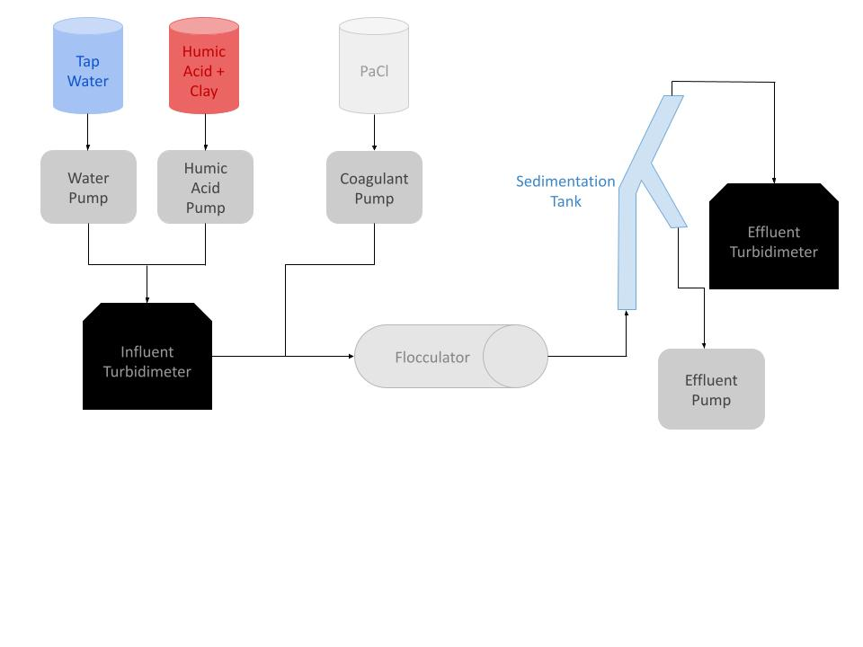
Schematic Drawing
Figure 5: Schematic drawing of the experimental set up for testing varying humic acid, coagulant, and clay concentrations
Dissolved Organic Matter | Research | Symposium Presentation Fall 2022 | Page 7
Notes:
Nhi
Brief schematic drawing of process/show general flow of solutions:
Clay is added to our humic acid solution which is then pumped in with water and combined before entering the influent turbidimeter. We use PaCl, (also known as polyaluminum chloride) as our coagulant, which is added to the humic acid - water solution and enters the flocculator where flocs form. It then moves into the sedimentation tank where the wastewater with floccs travels down the sloping branch due to gravity, and the clear water rises to the top. The clean water will then enter the effluent turbidimeter to measure the absorbance and turbidity of the water. There should be a smaller turbidity with the effluent stream compared to the influent stream as the turbidimeter measures the clarity of the fluid.

Slide 8
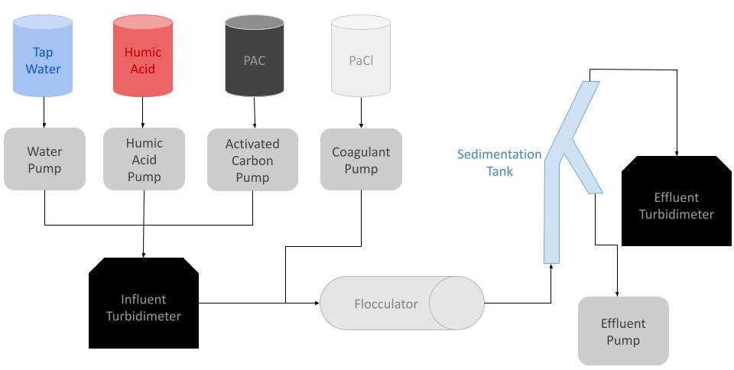
Schematic Drawing
Figure 6: Schematic drawing of the experimental set up for testing varying humic acid, coagulant, and PAC concentrations
Dissolved Organic Matter | Research | Symposium Presentation Fall 2022 | Page 8
Notes:
Nhi
We have a similar schematic for the other experiments we will like to run. The main differences is that there will not be clay added to the humic acid solution and that we will have another pump with activated carbon which will combine with humic acid and water before entering the influent turbidimeter.

Slide 9
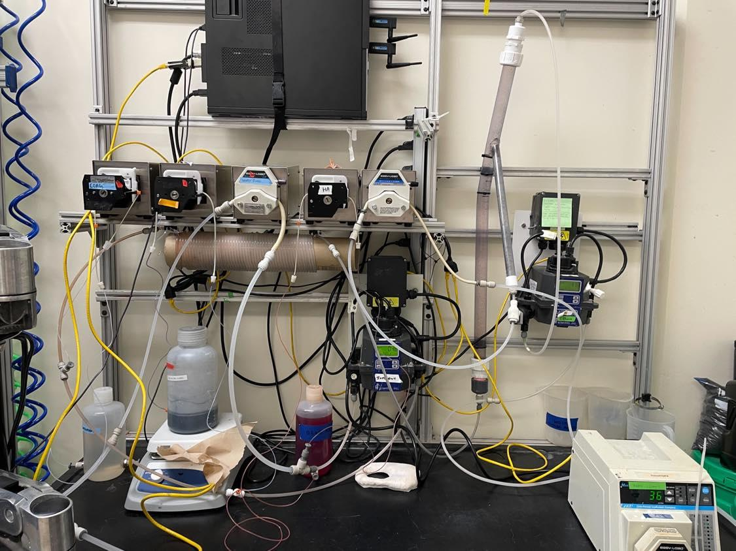
Experimental Setup
Water pump
Sedimentation Tank
Coagulant pump
Wastewater pump
Activated carbon pump
Humic acid pump
Effluent Turbidimeter
Influent Turbidimeter
Flocculator
Figure 7: Image of lab set-up and experimental design
Dissolved Organic Matter | Research | Symposium Presentation Fall 2022 | Page 9
Notes:
Nhi
We have five pumps: one for coagulant, activated carbon, humic acid, and water. A wastewater pump is used to ensure that the wastewater leaves the system.
Water is pumped from the inlet and combined with the humic acid and activated carbon which then then goes into the influent turbidimeter. They combine with coagulant and goes into the flocculator. Afterwards, it goes into the sedimentation tank and then the effluent turbidimeter.

Slide 10
Current Work
Calibrate turbidimeters
Re-downloaded ProCoDA
Reset Modbus IDs of the pumps and turbidimeters
Update the correct settings for the turbidimeters
Download the correct driver for our Modbus port
Dissolved Organic Matter | Research | Symposium Presentation Fall 2022 | Page 10
Notes:
Rachel
In the lab so far, we have calibrated the turbidimeters. However, we had to replace our second turbidimeter and we recently ran into issues with calibrating it. Since we got new computers in the lab, we had to redownload ProCoDA and reset the Modbus IDs of the pumps and turbidimeters. We ran into issues setting the IDs of the turbidimeters as we learned we had to manual change the ID settings on the turbidimeter itself and not on ProCoDA which is very different from the procedures with the pump. We also had connectivity issues with ProCoDA since the driver was not installed correctly when setting up ProCoDA. We had to find the driver online and set it up properly on the computer.

Slide 11
Methods
Find optimal coagulant dosage by
Varying coagulant dosage for 5 mg/L of humic acid concentration with
clay
activated carbon
Increase concentration of humic acid and repeat
Dissolved Organic Matter | Research | Symposium Presentation Fall 2022 | Page 11
Notes:
Rachel
In the beginning of the semester, we improved our experimental setup by replacing old tubing and equipment. We also installed and set up ProCoDA, and are using the same setpoints as the ones used last year. The setpoints for our ProCoDA method file is in our appendix slides (page 19). To find the optimal coagulant dosage, we will make solutions of various concentrations of coagulant on 5 mg/L of humic acid solution. The humic acid solution was also have clay which helps provide turbidity readings since the density of humic acid and water are similar. Afterwards, we will run the same experiment, but without clay in the humic acid, and with activated carbon, to find the optimal coagulant dosage. We will then compare the data side by side to see if there are positive effects with the addition of activated carbon. We will repeat these trials for increasing concentrations of humic acid.
Materials: Clay helps provide turbidity readings due its larger particle size. Humic acid is used as a model of dissolved organic matter. Activated carbon is used as substitute for clay and for other filtering effects. The pumps pump fluid into and out of the system. The turbidimeter measures how clear the sample is. The sedimentation tank separates floccs from clean water. The flocculator is where floccs form.

Slide 12
​​
Coagulant Concentrations
Concentration of Humic Acid (mg/L) | Optimal Coagulant Dosage (mg/L)
5 | 1.6 - 1.8
10 | 1.3
20 | 2.4
25 | 3.0
5 mg/L Humic Acid | 10 mg/L Humic Acid | 15 mg/L Humic Acid | 20 mg/L Humic Acid | 25 mg/L Humic Acid
Coagulant dosages: 0.8 mg/L 1.0 mg/L 1.2 mg/L 1.4 mg/L 1.6 mg/L 1.8 mg/L 2 mg/L | Coagulant dosages: 0.8 mg/L 1.0 mg/L 1.2 mg/L 1.4 mg/L 1.6 mg/L 1.8 mg/L 2 mg/L | Coagulant dosages: 1.6 mg/L 1.8 mg/L 2 mg/L 2.2 mg/L 2.4 mg/L 2.6 mg/L 2.8 mg/L | Coagulant dosages: 2 mg/L 2.2 mg/L 2.4 mg/L 2.6 mg/L 2.8 mg/L | Coagulant dosages: 2.4 mg/L 2.6 mg/L 2.8 mg/L 3.0mg/L 3.4 mg/L 3.8 mg/L 4.0 mg/L
Figure 3: Table of optimal coagulant dosages corresponding to specific concentrations of humic acid
Figure 8: Table of coagulant concentrations to use for different concentrations of humic acid.
Dissolved Organic Matter | Research | Symposium Presentation Fall 2022 | Page 12
Notes:
Rachel
For our preliminary experiments, we plan on making solutions of these coagulant concentrations for these dosages of humic acid based on experimental results from 2017-2020. We based these values from the table in Figure 3 where we are going to use values within 1 mg/L from the optimal coagulant dosage for those concentrations of humic acid.

Slide 13
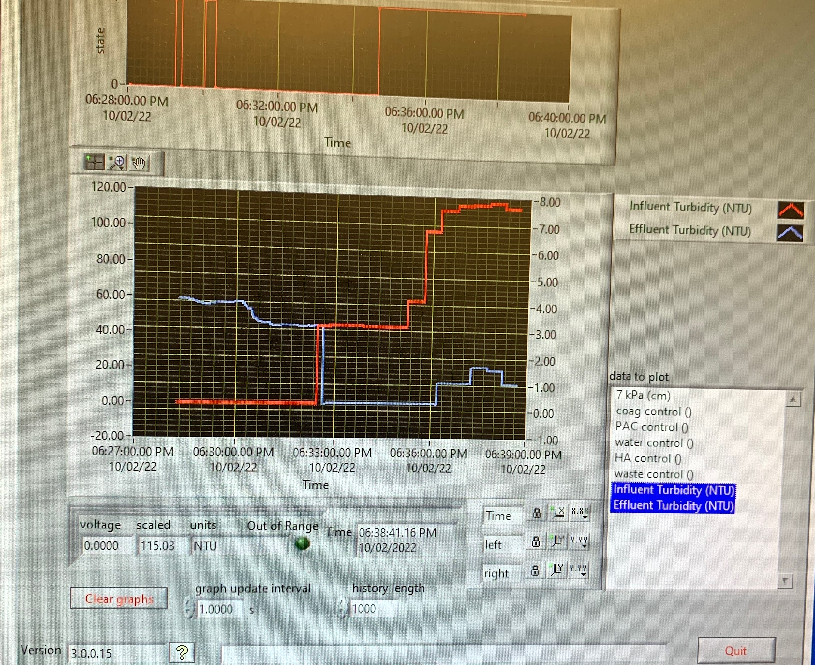
Results and Analysis
Figure 9: Table of coagulant concentrations to use for different concentrations of humic acid
Dissolved Organic Matter | Research | Symposium Presentation Fall 2022 | Page 13
Notes:
Rachel
When running preliminary experiments, we were able to make a graph on ProCoDA with a trial using 1 g/L of coagulant with 0.2 g/L of humic acid. The red plot represents the influent turbidity and the blue plot represents the effluent turbidity. From the graph, you can see that as time increases the influent turbidity increases and the effluent turbidity decreases. This makes sense because humic acid is continuously being pumped into the influent turbidimeter, and the stream entering the effluent turbidity is the clean water which has greater clarity or lower turbidity than the stream entering the influent turbidimeter.

Slide 14
Future Work
Finish calibrating our second turbidimeter
Make different concentrations of coagulant solutions
Vary concentrations of humic acid and concentrations of coagulant to prove a positive relationship among both solutions
Run similar experiments but without clay in the humic acid solution and with activated carbon
Dissolved Organic Matter | Research | Symposium Presentation Fall 2022 | Page 14
Notes:
Brooke
We have had issues calibrating the turbidimeter. It reads higher concentration values (1000 ntu and 10 ntu), but fails to read 0.02 ntu. We are currently in the process of figuring out how to properly calibrate the turbidimeter so that it can accurately read all concentrations for our future
Our second goal is to making different concentrations of coagulant solutions because we are trying to figure out how much coagulant (PACl) is needed to remove humic acid.
Our third goal is to confirm that as we increase humic acid, we need more coagulant to remove the extra humic acid. The previous years somewhat show this correlation, but not as strongly/accurately as we predict it exists. So we are varying coagulant dosages for different amounts of humic acids to collect more accurate data and find the optimal dosage of coagulant for different concentrations of humic acid.
Lastly, we want to discover the relationship between amount of humic acid and amount of activated carbon needed. We predict that as we increase humic acid, we need more activated carbon. We plan to find the optimal dosage of activated carbon for different concentrations of humic acid.
To prove this relationship and find optimal dosage, we will use the same experimental setup that we did with clay, except this time we will use activated carbon instead of clay. The goal is to explore the effects of activated carbon.
Too much coagulant will make too big of a floc and complicate the filtration process. Too little coagulant will mean the flocs will be too small and the contaminated particles will remain in the water. In these experiments, we are using the same amount of clay each time (5 grams of clay), but we are varying the amount of humic acid.
(Now explaining what this entails: Each week, we will use a set amount of humic acid and then test it first on clay and then activated carbon. This is so that the conditions will be the same for both clay and activated carbon. Each following week, we will up the dosage of humic acid and then run the experiments with both clay and activated carbon. The purpose of this is to compare the effectiveness of activated carbon versus clay at forming flocs and providing clean water.)

Slide 15
Questions
and/or
Recommendations?
Rachel Lai | rml267@cornell.edu Nhi Nguyen | npn25@cornell.edu
Zachary Kwon | zk49@cornell.edu Brooke Paykin | bsp67@cornell.edu
Dissolved Organic Matter | Research | Symposium Presentation Fall 2022 | Page 15
Notes:
Brooke
Atlas, this is the end of the presentation. If you have any questions or recommendations, feel free to contact anyone on the team. Thank you for listening!

Slide 16
References
Logan, B. E., Hermanowicz, S. W., & Parker, A. S. (1987). A Fundamental Model for Trickling Filter Process Design. Journal (Water Pollution Control Federation), 59(12), 1029–1042.
Matilaninen, A, Vepsalainen, M & Sillanpaa, M. (2010). Natural Organic Matter Removal by Coagulation during Drinking Water Treatment. Adv Colloid Interface Sci.
Soh, YC, Roddick, F & Van Leeuwen, J. (2008). The Impact of Alum Coagulation on the Character, Biodegradability and Disinfection By-product Formation Potential of Reservoir Natural Organic Matter (NOM) Fractions. Water Sci Technol. 58(6), 1173-9.
Kopfler, F., H. Ringhand, W. Coleman, AND J. Meier. REACTIONS OF CHLORINE IN DRINKING WATER, WITH HUMIC ACIDS AND 'IN VIVO'. U.S. Environmental Protection Agency, Washington, D.C., EPA/600/D-84/196 (NTIS PB85160737).
Du, Y. (2017). Observations and a Geometric Explanation of the Effects of Humic Acid on Flocculation.
Lin, V. S. (2015). Research highlights: Challenges in the characterization, storage, and isolation of natural organic matter. Environmental Science: Processes & Impacts, 17(12), 2002–2005. https://doi.org/10.1039/c5em90046h
Powdered activated carbon. Eleven Carbon ™. (2022, April 3). Retrieved October 17, 2022, from https://elevencarbon.com/powdered-activated-carbon/
Dissolved Organic Matter | Research | Symposium Presentation Fall 2022 | Page 16

Slide 17
Appendix
Slides
Dissolved Organic Matter | Research | Symposium Presentation Fall 2022 | Page 17

Slide 18

Schematic Drawings
Figure 5: Schematic drawing of the experimental set up for testing varying humic acid, coagulant, and clay concentrations
Figure 6: Schematic drawing of the experimental set up for testing varying humic acid, coagulant, and PAC concentrations
Dissolved Organic Matter | Research | Symposium Presentation Fall 2022 | Page 18
Notes:
Clay is added to our humic acid solution which is then pumped in with water and combined before entering the influent turbidimeter. We use PaCl, (also known as polyaluminum chloride) as our coagulant, which is added to the humic acid - water solution and enters the flocculator where flocs form. It then moves into the sedimentation tank where the wastewater with floccs travels down the sloping branch due to gravity, and the clear water rises to the top. The clean water will then enter the effluent turbidimeter to measure the absorbance and turbidity of the water. There should be a smaller turbidity with the effluent stream compared to the influent stream as the turbidimeter measures the clarity of the fluid.
We have a similar schematic for the other experiments we will like to run. The main differences is that there will not be clay added to the humic acid solution and that we will have another pump with activated carbon which will combine with humic acid and water before entering the influent turbidimeter.

Slide 19
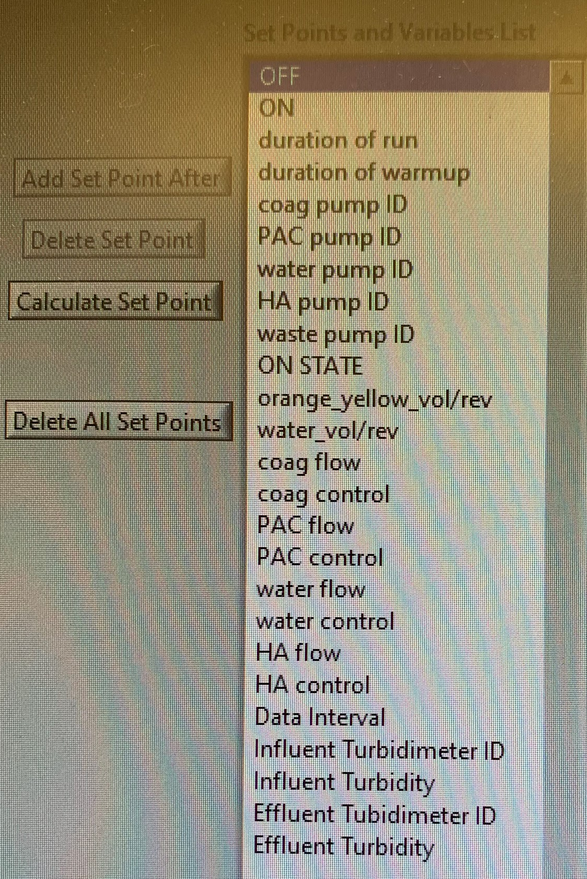
Setpoints
Figure 10: Image of the setpoints of the ProCoDA method file
Dissolved Organic Matter | Research | Symposium Presentation Fall 2022 | Page 19
Notes:
Attached above is an image of our ProCoDA setpoints.

